Slide 1
Fundamentals of Financial Method

Slide 2
Procedures for Economic Analysis
Environmental
(Political) Analysis
Cost Analysis
Economic Analysis
Technology Characteristics
Analysis
Benefit Analysis
Economic Justification
- NPV, IRR, PB
- ROI
- B/C ratio

Slide 3
Time Value of Money
Value of money changes over time
Economic equivalence should be introduced to determine the different amount of money at different points in time
Present Worth: To determine the present worth P of a given future amount F at discount rate i
Discount rate: financing cost + risk + earning rate + …
Minimum Attractive Rate of Return (MARR)
A project is not economically viable unless it is expected to return at least the MARR
Hurdle rate, Cut-off rate
Weighted Average Cost of Capital (WACC)
Weighted average cost of equity financing and debt financing
Risk Premium : evaluation on the risks involved in the investment

Slide 4
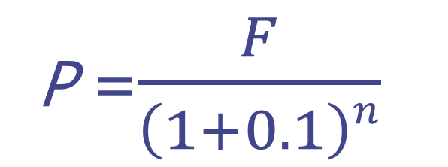
Equivalence of Present & Future Value
F ??
...
1 2 3 … n
P
MARR=10%
P =$\frac{F}{\left(1+0.1\right)n}$

Slide 5
Present Value, Future Value, Annual Value
F ?
1 2 3 … n
P
P
A
F
A
…
1 2 3 … n
P ?

Slide 6
Financial Evaluation Methods
Financial Evaluation
Profitability
Public Benefit
Stability
NPV
(Net Present
Value)
IRR
(Internal Rate
Of Return)
PI
(Profitability Index)
B/C Ratio
(Cost-Benefit
Analysis)
PP
(Payback Period Method)

Slide 7
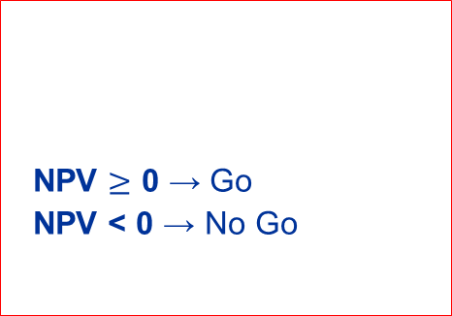

Profitability
Net Present Value : (NPV)
NPV
(Net Present Value)
All future costs and revenues are transformed to equivalent monetary
units NOW ⇒ IF NPV $≥$ 0, then it is economically viable
MARR 10%
Present Value
Decision Guideline
60
50
118.61
40
NPV $≥$ 0 → Go
NPV < 0 → No Go
20
NPV = PV _{in} – PV _{out}
-
10
109.09
100
-
NPV = 9.52
☜ Accepted !!
WARNING !
The comparison must be made for equal-service periods
NPV does not show earned rate of capital invested

Slide 8

Profitability
Internal Rate of Return (IRR)
IRR
(Internal Rate of Return)
Rate of return that makes NPV zero
⇒ IF IRR $≥$ MARR, then it is economically viable
MARR 10%
IRR
Decision Guideline
60
50
0 = - 100
- 10 ÷ (1 + i)
+ 20 ÷ (1 + i)²
+ 40 ÷ (1 + i)³
+ 60 ÷ (1 + i)⁴
+ 50 ÷ (1 + i)⁵
40
i ≥ MARR → Go
i < MARR → No Go
20
∑ { NCF_{t} ÷ (1+ i)^{t} }=0
10
100
IRR = 12.56%
☜ Accepted!!
WARNING !
There may exist none or multiple values
Higher IRR does not guarantee better alternative among the mutually exclusive alt.s

Slide 9

Profitability
Profitability Index(PI)
PI
(Profitability Index)
Divide NPV(PW of NCF_{t}, t=1,2,…,n) by initial invested capital
MARR 10%
NPV of NCF_{t}
Decision Guideline
60
50
109.52
40
PI $≥$ 1 → Go
PI < 1 → No Go
20
PI = NPV÷IC×100(%)
/
10
100
100
PI = 1.10
NCF = Market size to be created x Operating Profit rate x Success Rate x
Project Contribution rate x R&D Contribution rate (KISTEP, 2011)
Estimation of NCF is rather complex
WARNING !

Slide 10
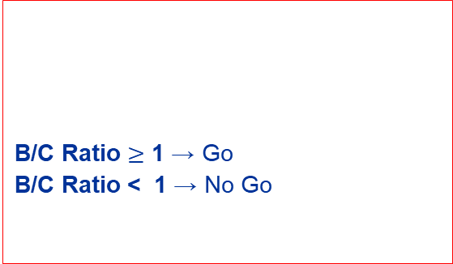
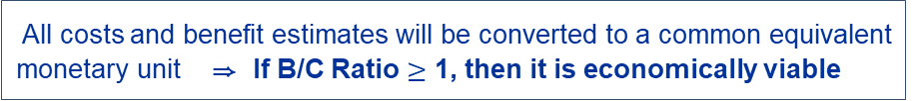
Public Benefit
B/C Ratio Analysis
B/C Ratio
(Cost Benefit Analysis)
All costs and benefit estimates will be converted to a common equivalent
monetary unit ⇒ If B/C Ratio $≥$ 1, then it is economically viable
Public discount rate 10%
NPV
Decision Guideline
60
50
118.61
40
B/C Ratio $≥$ 1 → Go
B/C Ratio < 1 → No Go
20
B/C Ratio = P(A)V _{benefit} / P(A)V _{cost}
/
10
109.09
100
B/C Ratio = 1.09
☜ Accepted !!
How to determine public discount rate ?
How to quantify Intangible cost and benefit ?
How to consider technology risk premium ?
WARNING !

Slide 11
Stability
Payback Period (PP)
Payback Period Method
Estimate time for the revenues to completely recover the initial
investment ⇒ A project with shorter PP will be selected
Simple Payback Period
Time
0
1
2
3
4
5
(1) Cash Flow
-100
-10
20
40
60
50
(2) Accumulated CF
-100
-110
-90
-50
10
60
Discounted Payback Period(i= 10%)
Time
0
1
2
3
4
5
⑴ Cash Flow
-100
-10
20
40
60
50
⑵ Cost of Capital
0
-10
-12
-11
-8
-3
⑶ Accumulated CF
-100
-120
-108
-80
-28
19
WARNING !
Supplemental analysis technique used primarily for initial screening prior to a full
evaluation by other methods

Slide 12
Spreadsheet Functions
(1) Present Value, P: = PV(i%,n,A,F)
(2) Future Value, F: = FV(i%,n,A,P)
(3) Equal, periodic value, A: = PMT(i%,n,P,F)
(4) Number of periods, n: = NPER(i%,A,P,F)
(5) Compound interest rate, i: = RATE(n,A,P,F)
(6) Compound interest rate, i: = IRR(first_cell:last_cell)
(7) Present value, any series, P: = NPV(i%, 2nd_cell:last_cell) + first_cell

